Slide 1
Application Configuration Kick-off
Month/DD/YYYY

Slide 2
The Anaplan Way for Apps Template
REMOVE BEFORE PRESENTING
Pre-Delivery
Config
Config
Test & Deploy
Extension Design
Iterative Extension
Extension Test & Deploy
Project Kick-off ​Template
The purpose of this document is to set the stage for the Project deliverables. The document will contain important information from the Pre-sales cycle as well as the SOW. During the set up the kick-off meeting (and deck) items such as the success criteria, summary of functionality purchased (scope), implementation approach, roles and responsibilities, governance and timelines will be documented to ensure alignment.
Instructions:
Replace any yellow content with customer-specific details
Replace any red content with application-specific details
Remove build notes and any slides marked "Remove Before Presenting"
Paste Customer logo and any other formatting desired by customer

Slide 3
Agenda
Project Objectives and Timeline
Project Governance, Resourcing and Schedule
Application Overview
Key Next Steps
How we Deliver: Ethos and Methodology
Appendix

Slide 4
Introductions - Customer
Build Notes
Have customer provide attendees and titles
Remove before final delivery

Slide 5
Introductions - Delivery Team
Build Notes
PM to update with delivery team
Remove before final delivery

Slide 6
Project Objectives and Timeline

Slide 7
Build Notes
If a Sponsor is present, ask them to speak for a few minutes on project goals. If not, capture and share a Sponsor quote with the team.
Forword from the project sponsor.”
John Doe
Job Title, Company
Remove before final delivery

Slide 8
Project Manifesto
Build Notes
Sample - replace all highlighted text and/ or slide with customer-specific names, terms, and values
Mission: What are we trying to accomplish?
Means: How do we achieve our mission?
Membership: What do we offer each other?
Enter customer mission
Enter customer means
Enter customer membership
Remove before final delivery

Slide 9
Executive Summary – Goals and Success Measures
Build Notes
Populate this slide using inputs from the Sales handoff. If not provided, align with Sales and customer sponsors/leads to confirm the customer vision, business problem, and solution expectations.
Vision
Business Problem
Solution Expectations
Enter customer-specific vision from Sales Handoff Process
Enter customer-specific business problem from Sales Handoff Process
Enter customer-specific expectations from Sales Handoff Process
Remove before final delivery

Slide 10
Project Timeline
Legend
◆ Milestone
● Go-Live
Build Notes
Adjust the timeline and phasing to reflect the specific customer and application.
Activity | W1 | W2 | W3 | W4 | W5 | W6 | W7 | W8 | W9 | W10 | W11 | W12
Pre-Project
Sales Knowledge Transfer
Delivery Scope Alignment & KO
Baseline Application (No Extensions)
Granularity workshop
Dimension Configuration
Hierarchy and time Configuration
Playback session to validation the granularity
Solution Configuration & Creation
Model Familiarization and Training
Playback session to validate the scope of solution
UAT and Sign-off
Collect feedback on the scope
Change Management and Deployment
User Adoption and Training
Application Deployment
Post Go Live support
Go-Live
Remove before final delivery

Slide 11
Project Timeline
Legend
◆ Milestone
● Go-Live
Build Notes
Activity | W1 | W2 | W3 | W4 | W5 | W6 | W7 | W8 | W9 | W10 | W11 | W12 | W13 | W14 | W15 | W16 | W17 | W18 | W19 | W20 | W21 | W22 | W23 | W24 | W25
Pre-Project
Sales Knowledge Transfer
Delivery Scope Alignment & KO
Baseline Application (No Extensions)
Granularity workshop
Dimension Configuration
Hierarchy and time Configuration
Playback session to validation the granularity
Solution Configuration & Creation
Model Familiarization and Training
Playback session to validate the scope of solution
UAT and Sign-off
Collect feedback on the scope
Extensions
Extension Review and Analysis
User Stories / Workshops
Implementation Sprints
Sprint 1
Sprint 2
Sprint N
Automated Data Loads
Change Management and Deployment
User Adoption and Training
UAT Preparation + SIT
UAT
Extension Roll out
Post Go Live support
Adjust the timeline and phasing to reflect the specific customer and application.
Only use this slide if it's known that there will be extensions.
Official Kickoff
Base Application Live (if no extensions identified)
Backlog Created
Extensions Completed
Application is fully operational
Remove before final delivery

Slide 12
Application Overview

Slide 13
Territory & Quota Planning – Application Overview
Build Notes
Explain how the application supports the customer’s planning processes and the business outcomes it enables. Keep content high-level and outcome-focused, and tailor language to the customer context.
How Anaplan helps
What this enables
With Anaplan, CUSTOMER can modernize territory and quota planning on a single connected platform.
Connect GTM data, targets, and capacity to create a unified source of planning truth.
Design balanced, equitable territories aligned to accounts, segments, and coverage models.
Align top-down revenue targets with bottom-up account and pipeline potential.
Manage complex roles, overlays, and account hierarchies with built in governance and workflows.
Apply proven best practices to maintain consistency and accuracy as plans evolve.
This enables CUSTOMER to plan faster, with greater confidence and alignment.
Reduce manual, spreadsheet driven effort and shorten planning cycles.
Deliver fair, motivating quotas that support GTM and corporate strategy.
Improve visibility and accountability through streamlined approvals.
Focus sales teams on highest potential accounts and territories.
Drive stronger cross functional alignment and better revenue decisions.
Remove before final delivery

Slide 14

Territory & Quota Planning – Application Overview
Build Notes
Replace the orange content with the planning areas included in the application being deployed for this project.
Use the hex visual to represent the scope of planning supported and confirm included areas with Sales before finalizing.
Please see any material provided by Anaplan Product teams.
What’s included?
Fully functional Planning model + UX app
Prebuilt Data Hub/ADO
Architectural Best Practices
Structured Business Planning Processes
Novel Guided Setup System
Target Allocation (Top-Down & Bottom-Up)
Quota Setting & Allocation
Coverage & Capacity Planning
Territory Design & Balancing
Approvals & Governance
Remove before final delivery

Slide 15

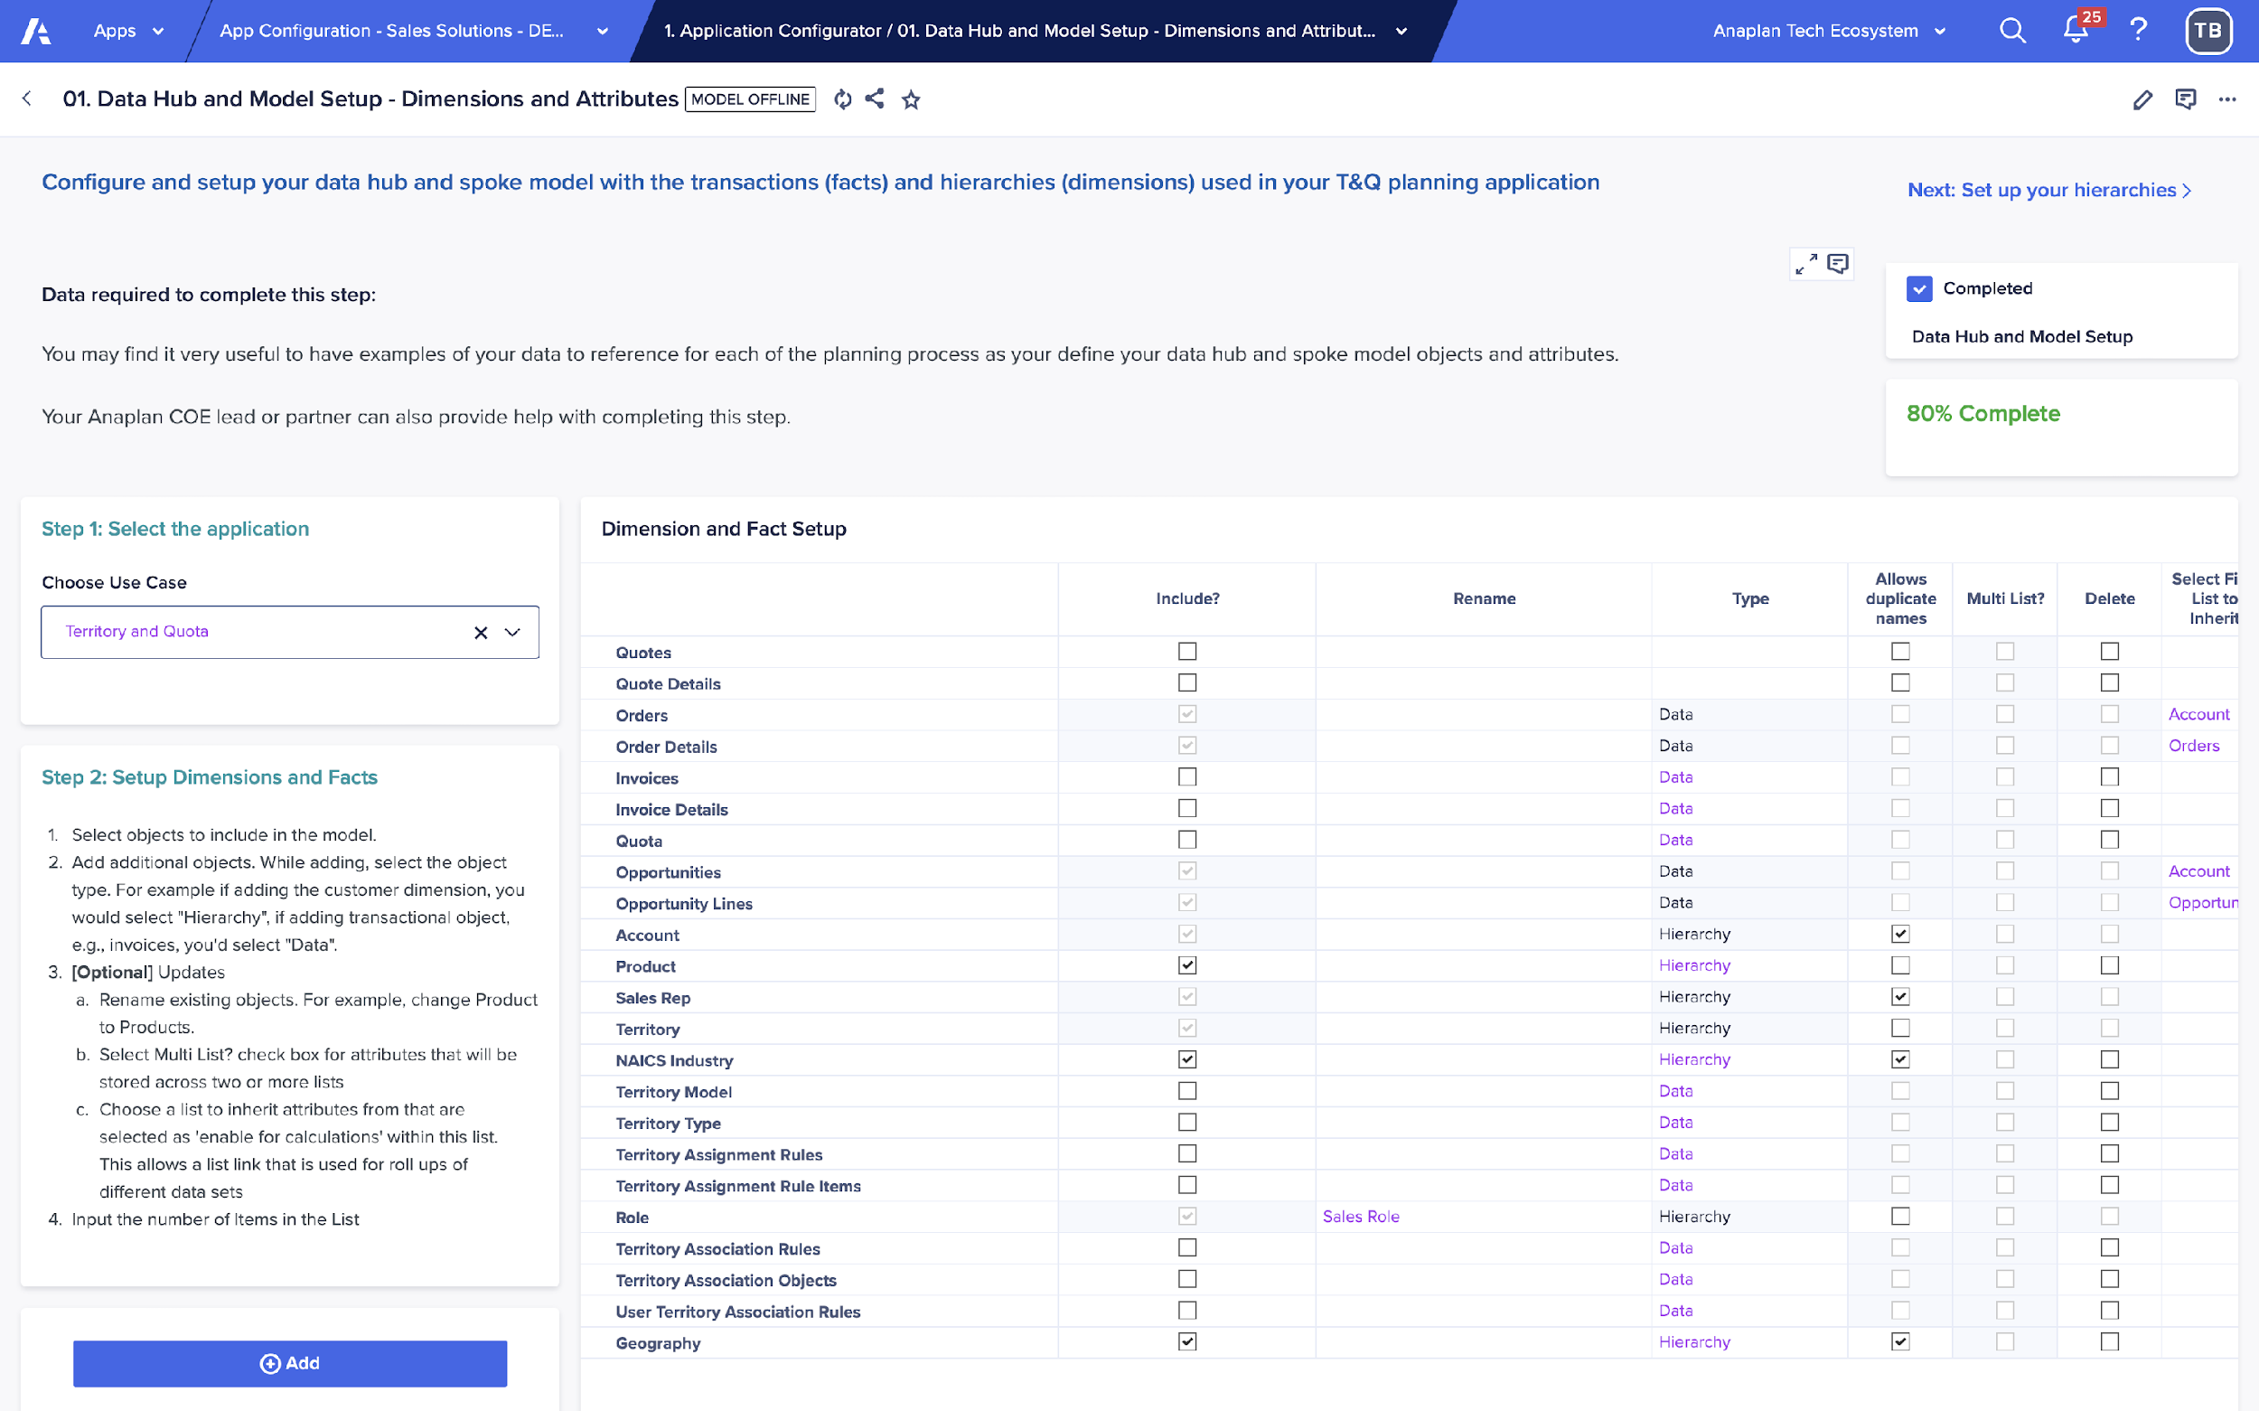
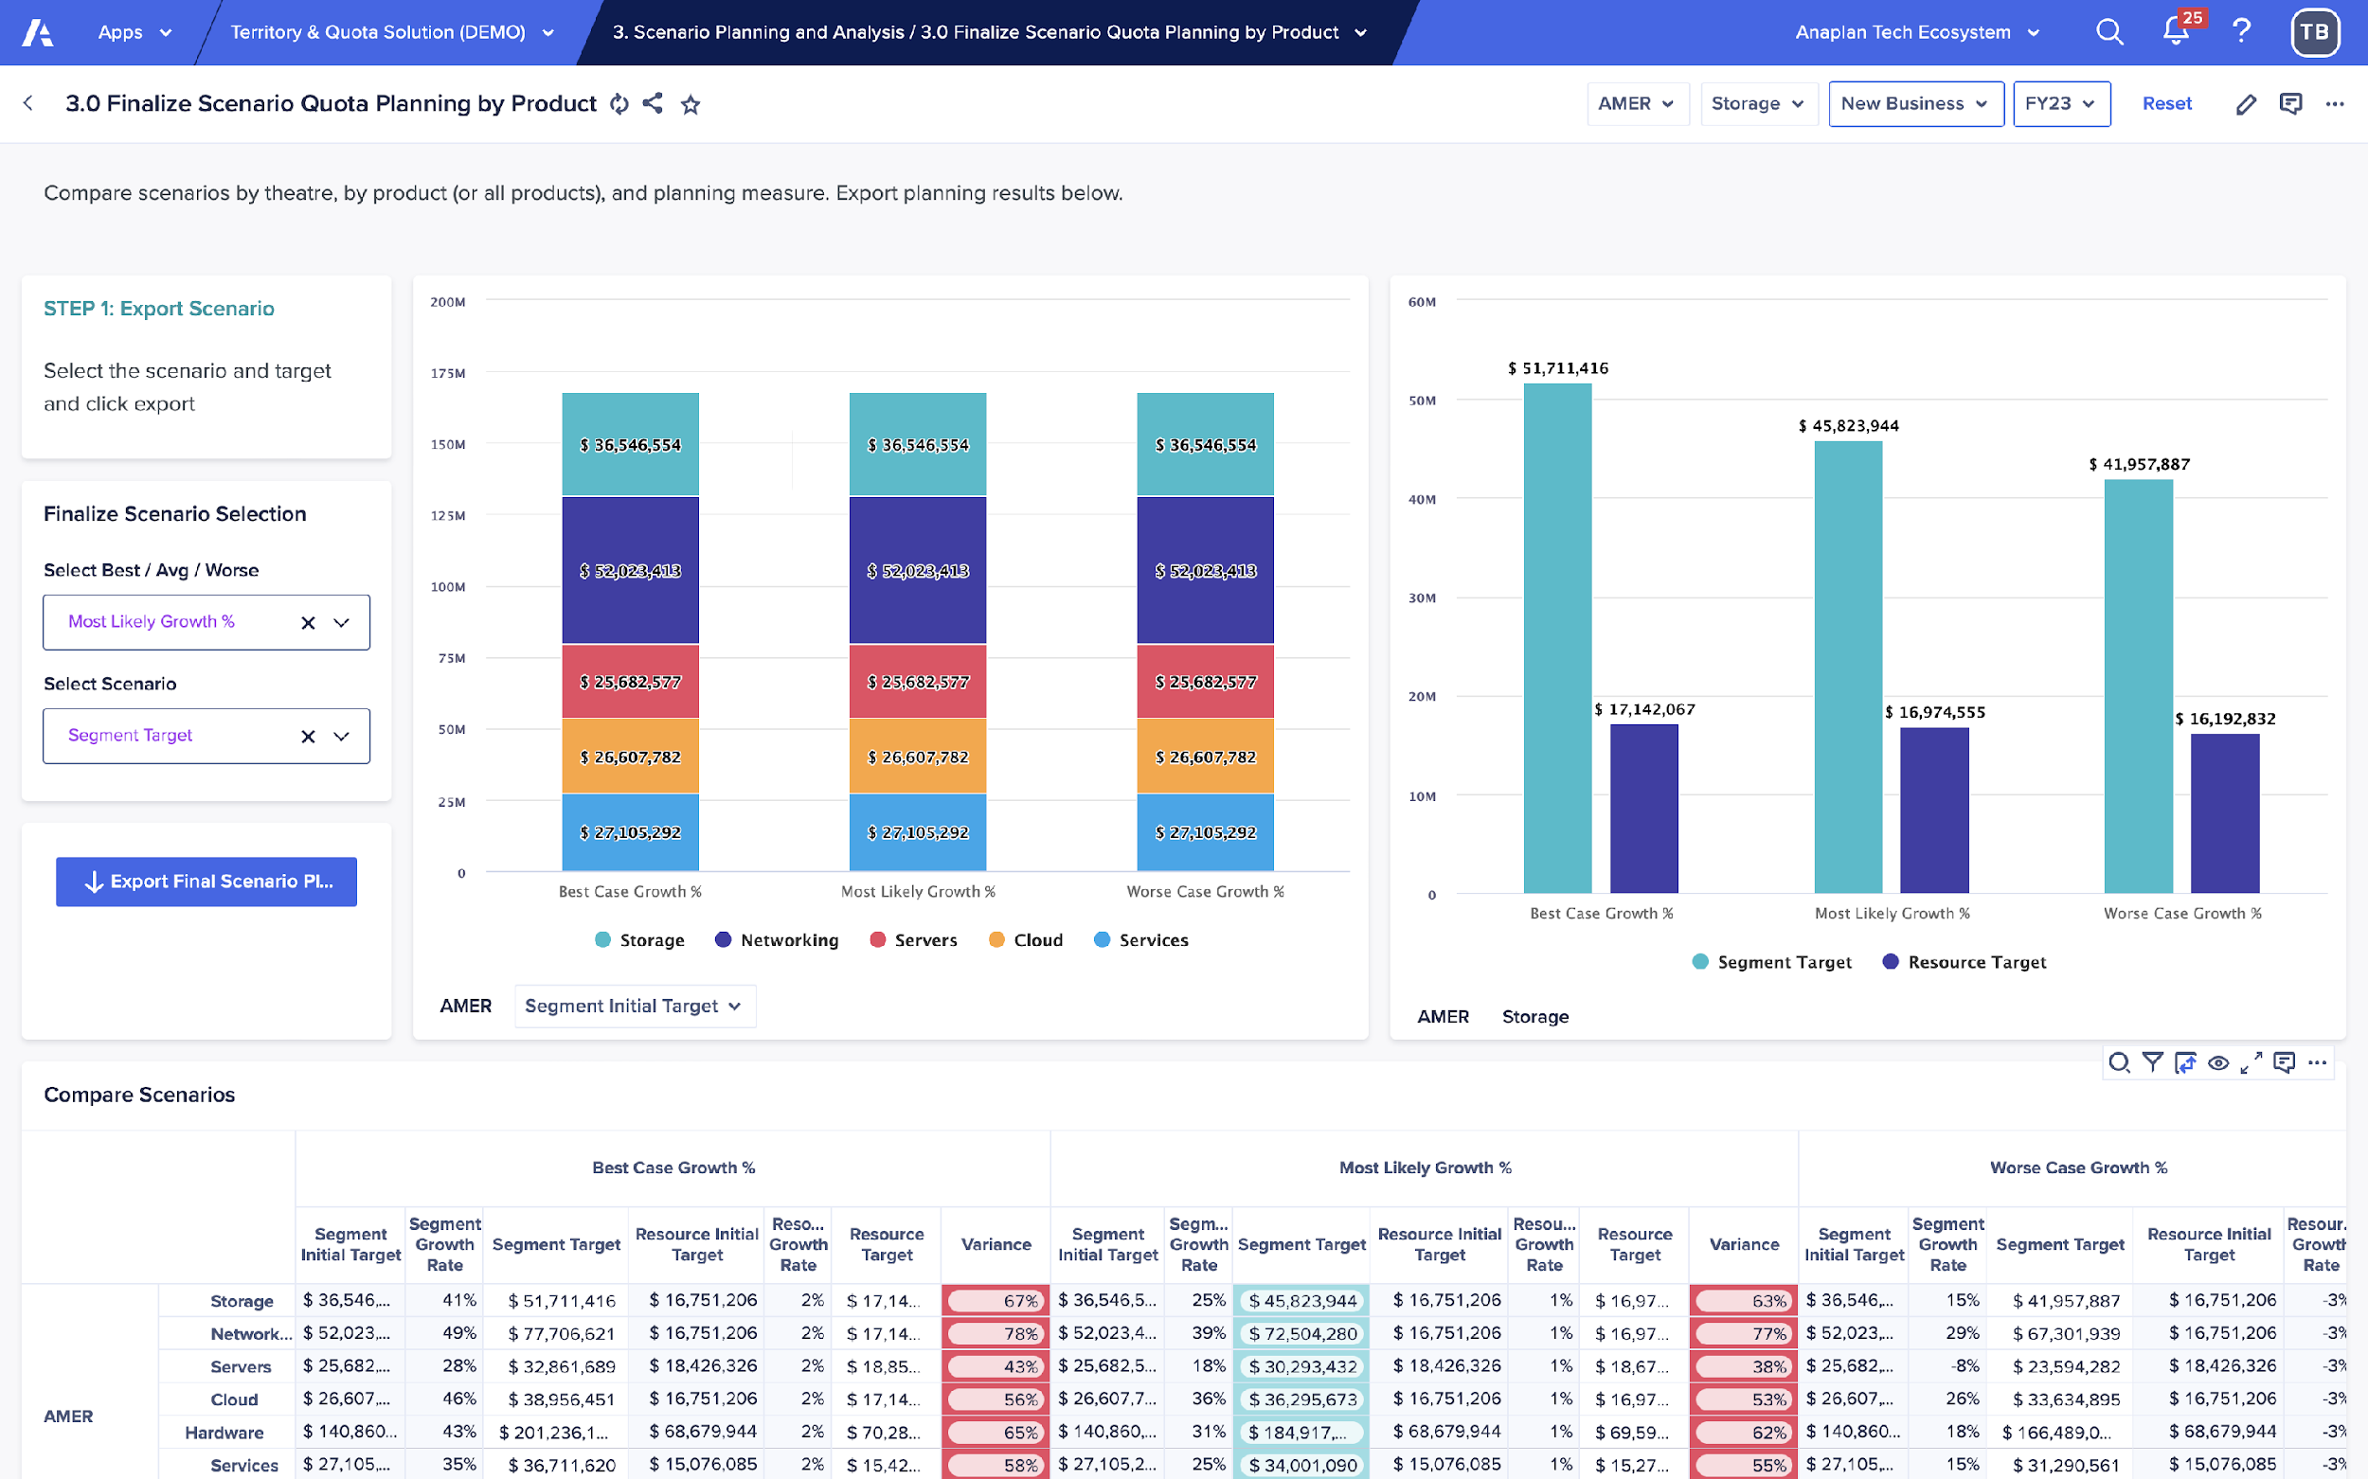
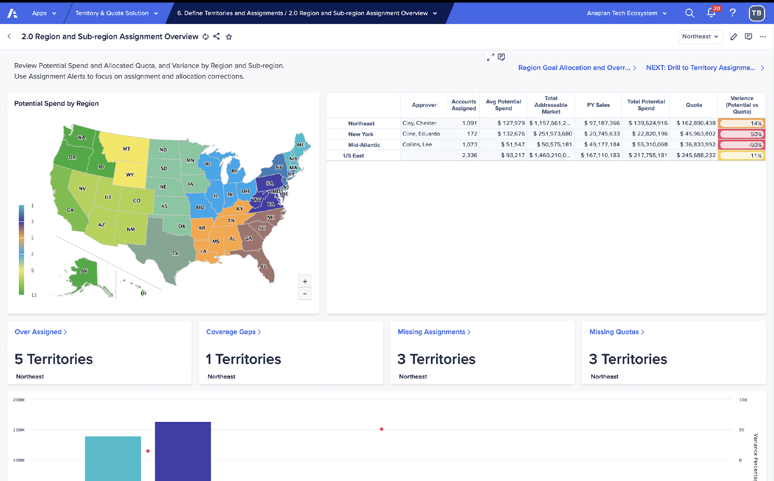
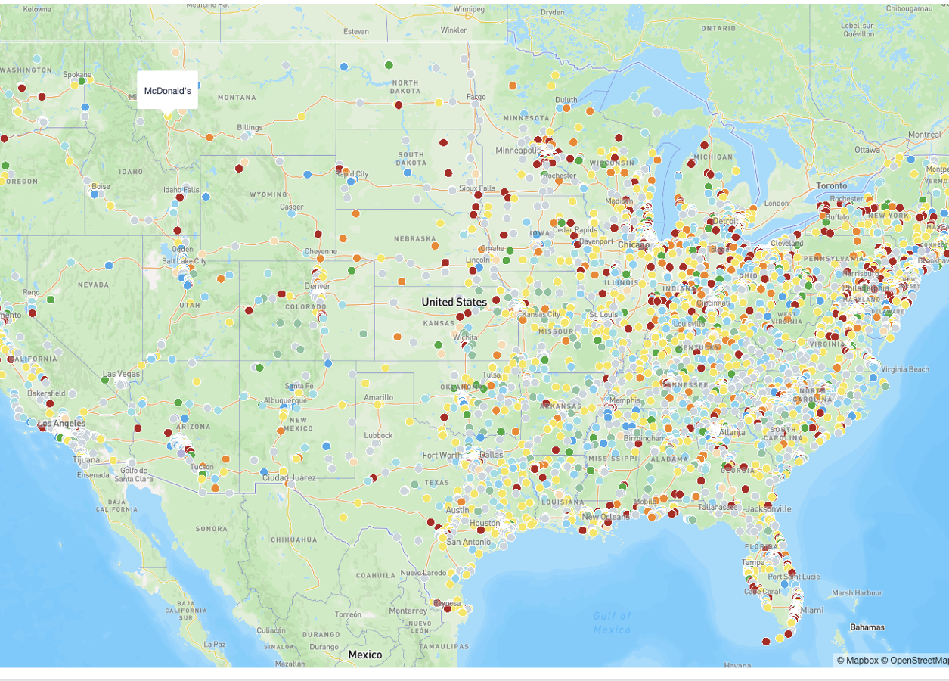
Anaplan Application: Territory & Quota Planning
Build Notes
Why this application was selected and the outcomes it supports
Use content from the Sales handoff or pre-sales materials to explain why this application was selected and the outcomes it supports. Ensure continuity with the solution sold. Where possible, have the sponsor briefly reinforce the business rationale during delivery.
Business purpose
Key outcomes
Selected to replace manual, spreadsheet based T&Q planning with a governed, scalable GTM planning process.
Balance territories aligned to GTM strategy and account potential.
Align top-down targets with bottom-up quotas and capacity.
Support faster coverage and quota decisions.
Delivers faster planning cycles and more equitable, actionable plans.
Eliminates manual spreadsheets and fragmented approvals.
Accelerates quota delivery to the field.
Improves visibility, alignment, and seller confidence.
Remove before final delivery

Slide 16
Territory & Quota Planning – Supported Planning Processes
Build Notes
Core Processes Supported
Design and maintain balanced sales territories aligned to GTM strategy.
Assign and reassign accounts to territories at scale using rules and governance.
Allocate revenue targets top down and distribute quotas bottom up.
Align coverage, capacity, and roles across sellers, overlays, and managers.
Review, approve, and finalize territory and quota plans with structured workflows.
Summarize the main business processes supported by the application. Keep content process-focused and high-level.
Remove before final delivery

Slide 17
How we deliver: Our Ethos and Methodology

Slide 18





Applications – w/ Extension
Base Application Go-Live
Project Kick-Off
Baseline Application
Testing
Deploy
UAT
Training
Post Deploy Support
No Extensions
Extended Application Go-Live
Pre-Project
Configuration
Scoping
SOW
Data Management
Iterative App Configuration
Application Led Design
Extensions Identified
Iterative Extension
Ext. Design
Etx. Build
Testing
Deploy
User
Stories
Sprint(s)
Training
UAT
Post Deploy Support
Automated Data Loads
Change Management / User Adoption
Fixed (X weeks)
Variable (Y-Z weeks)
Collection of Gap Items / Parking Lot / Backlog
Data Readiness
Manual Data Load (Flat File)
Automated Data Integration
Change Management / User Adoption
Notes:
**Instructions**
Delivery PM or team lead presents the Anaplan Way Methodology.
Pillars of the approach
1) Start with the Application:
Start with the application as a baseline
Take the model to production within X weeks.
Extend functionalities to maximize value
2) Foundation of Success:
Use our data templates
Sign off for our best in call process
Configuration of the application led by Anaplan
Strong involvement from key users during the initial configuration weeks to maximize adoption
3) Efficient Delivery: for the first weeks:
An iterative approach in which users will review the process with their data and define the right level of analysis
4) Agility in Action:
Frequent feedback loops and adaptive configuration, testing, and enablement to maximize adoption
5) Early training on the solution: Users will be trained on the application within the first several weeks to ensure production readiness

Slide 19



















The Anaplan Way for Applications
Build Notes
OPTIONAL PHASES
Pre-Project
Configuration
Test & Deploy
Extension Design
Extension Build
Ext Test & Deploy
This slide is an alternative to slide 18. Only one version will need to be used in the kick-off meeting.
Laying the groundwork through discovery, assessment, and
strategic planning
Building the
core solution by configuring the base application
Preparing the
base application for production with customer data
Designing enhancements and custom functionality based on identified business needs
Enhancing the application with customer-specific features
Validating the solution and providing
launch support
Holding the Discovery Workshop
Reviewing scope, business processes, planning metrics, etc.
Signing the SOW
Conducting
App-Led Design Workshops
Analyzing, reviewing, and connecting customer data
Configuring the base application
Validating Customer Data, Lists, and Hierarchies
Identifying and documenting extensions
Completing UAT on the base application
Going live with the base application
Reviewing business needs from the App-Led Design Workshops and Interactive Walkthrough Sessions
Designing and
Planning Implementation for additional functionality
Executing on the sprint plan
Updating documentation
Loading production data
Preparing for
SIT and UAT
Training key users
Performing and signing off on testing
Providing support through an agreed number of cycles
Going live with the
application with extensions
Remove before final delivery

Slide 20
The Anaplan Way for Applications – Base Application Deployment
Build Notes
OPTIONAL PHASES
Pre-Project
Configuration
Test & Deploy
Extension Design
Extension Build
Ext Test & Deploy
This slide shows base application deployment while recognizing there may be extensions.
Discovery workshop
Project success drivers
Review planning metrics
Review functional scope
Review business processes
Application mapping (business need vs application coverage)
Data readiness & template review
Training of key users
Signed SOW
Sales Assets
Sales to Delivery Handoff
Data
Analyze customer data
Data strategy and mapping
Application Config & Design
Conduct App-Led Design Workshops
Upload customer data into application
Review data / planning granularity
Manage security
Configure application
Extension / additional use-case design and prioritization
Interactive walk-through session of the base application with customer
Data Validation
Configurations Close Checklist Completed
Configuration Phase Project Plan Signed Off
Application ready for production
Application guide review
Data validation
List and hierarchy validation
End-to-end data flow testing
User Acceptance Testing (UAT)
Preparation for go-Live
Production data loaded
Extensions
identified and documented
Base app UAT Signed Off
Base App Go-Live
Extension Design
Extension Design Kick-off
Detailed review of business needs from App-Led Design Workshops
Design and Implementation Plan for Additional Functionality
Create user stories
SOW/Change Order Signed
Extension Build
Sprint plan execution
Update SIT plan
Update UAT plan
Update admin training
Update user guide to include extensions
Functional Unit Testing Passed
Production Data Loaded
Customer Approval to move to SIT and UAT
Extension ready for production
Test Scripts Created
Superuser train the trainer sessions
Systems integration testing
User Acceptance Testing
UAT resolution and backlog management
Preparation for go-Live
Support through agreed number of cycle
SIT Signed Off
UAT Signed Off
App Go-Live!
Activities
Control Gates
Remove before final delivery

Slide 21
The Anaplan Way for Applications – Base Application + Extension Deployment
Build Notes
Pre-Project
Configuration
Extension Design
Extension Build
Ext Test & Deploy
This slide should be used as an alternative to slide 20 when it’s known that extensions will be included.
Discovery workshop
Project success drivers
Review planning metrics
Review functional scope
Review business processes
Application mapping (business need vs application coverage)
Data readiness & template review
Training of key users
Signed SOW
Sales Assets
Sales to Delivery Handoff
Data
Analyze customer data
Data strategy and mapping
Application Config & Design
Conduct App-Led Design Workshops
Upload customer data into application
Review data / planning granularity
Manage security
Configure application
Extension / additional use-case design and prioritization
Interactive walk-through session of the base application with customer
Data Validation
Configurations Close Checklist Completed
Configuration Phase Project Plan Signed Off
Extension Design
Extension Design Kick-off
Detailed review of business needs from App-Led Design Workshops
Design and Implementation Plan for Additional Functionality
Create user stories
SOW/Change Order Signed
Extension Build
Sprint plan execution
Update SIT plan
Update UAT plan
Update admin training
Update user guide to include extensions
Functional Unit Testing Passed
Production Data Loaded
Customer Approval to move to SIT and UAT
Extension ready for production
Application guide review
Data validation
List and hierarchy validation
End to end data flow testing
Test Scripts Created
Superuser train the trainer sessions
Systems integration testing
User Acceptance Testing
UAT resolution and backlog management
Preparation for go-Live
Support through agreed number of cycles
Production data loaded
SIT Signed Off
UAT Signed Off
Go-Live!
Activities
Control Gates
Remove before final delivery

Slide 22
Project Governance, Resourcing and Schedule

Slide 23
Project Team Introduction
Build Notes
Sponsorship
 | Role​ | Primary Responsibility ​
 | Executive Sponsor​ | Champion, escalation point, owns vision. Communicates project dependencies and strategic direction as to why we are doing the project​.
 | PS VP | Is accountable for Anaplan scope delivery, escalation point.
 | CS & EAE | Is Anaplan’s point of entry for all matters relating to the platform. Responsible for value creation and product adoption. Leads the review of Anaplan’s activity.
 | PO | Expert on Client processes. Liaises with the leadership team as needed to validate the end-to-end solution (UX, workflows, organization).
 | PM | ​Ensures project management, compliance with deadlines, monitoring of progress, issues and budget. Level 1 escalation point.
 | SIM​
 | Eng. Lead | Experienced supply chain professional with deep planning expertise. Challenges customer thinking and coaches & advises on best practice. Works across all levels of the organization.
 | SA​ | ​Is Technical and functional expert. Designs end-to-end solution. Demoes apps dashboards that best align with project objectives and evaluates customization needs. Provides data requirements.
 | MB | Builds and manages model customization, carries out maintenance.
 | Key Users​ | Provide expertise on local/central end-to-end business process​es. Review dashboards and conduct UAT.​
 | SME​ | Provide expertise on local/central data sources​. Provide expertise on as-is processes and review to-be processes.
 | IT Expert ​ | ​Co-ordinates with key IT stakeholders​ to deliver data to the project. Focuses on data, IT landscape and integration activities​.
Update with roles and names to align with project team
Sponsor
Professional Services Lead
Customer Success Team & Account Executives
Customer Success Director
CS Business Partner
Account Executive
Product
Senior Director
Project Management & Delivery
Product Owner
Project Manager
Engagement Lead
Project Manager
Implementation Team
Solution Architect
Model Builder
Delivery Assurance
Key Users
Data & Process SME
IT Expert
Manager Adoption
as needed
TBA Phase 1
Anaplan / Partner
Customer
Remove before final delivery

Slide 24
Project Governance and Team
Build Notes
  Steering Meeting Agenda
  Sponsor progress / direction
  Review / discuss options / impacts
  Make critical decisions timeously, approve implementation efforts
  Track program progress
  Configuration/ Extension Sprint Review Agenda
  Session to review outcomes from the Application-Led design sessions and configuration results
  Feedback collection
  Document possible Extension work
Update this content based on meetings with the customer PM to align with their project governance
.
.
  Account Executive
  Services Delivery Dir.
  Customer Success
  Project Manager
Steering Committee Meets every 3 weeks
Configuration Review
Meets during the configuration
  Project Manager
  Solution Architect
  Model Builders
  Customer Success
Executive Sponsors
Product Owners
Project Owners
  Project Manager / Product owner
  Key User
  Data SME
  Model Builder
.
.
Stand-Ups
Core Team Meets every day
Project Updates
Meets every week
  Daily Stand-Ups Agenda
  Manage and prioritize backlog of ideas/activities
  Track progress and blocking points
  Build team action plan
  Project Manager / Product owner
  Data SME (when required)
  Model Builder
  Project Manager / Product owner
  Data SME (when required)
  Model Builder
  Weekly Project Meeting Agenda
  Manage and prioritize backlog of ideas/activities
  Track progress and blocking points
  Build team action plan
  Project Manager
  Solution Architect
  Model Builders
  SMEs (when required)
  Project Manager
  Solution Architect
  Model Builders
  SMEs (when required)
Remove before final delivery
  Customer Team
  Delivery Team

Slide 25
Program Touchpoints
Build Notes
Align with the customer PM to align on meeting cadence and if possible, add the dates and participants
Audience | Name | Purpose | Frequency
Core Project Team | Application Implementation | Workstream touchpoint to share blockers, progress and plans. Alignment across workstream owners | WEEKLY
Extended Project Team | Customer Anaplan Implementation | Workstream touchpoint to share blockers, progress and plans. Alignment across workstream owners across Customer & Anaplan | WEEKLY
Core project team and customer SMEs | Daily Standup | Workstream touchpoint to share daily progress, blockers and questions during development. | DAILY (during configuration)
Workstream Owners & Project Leadership | Application Implementation - Decisions | Surface issues that arise across the Anaplan implementation project and align on decision | AD HOC
Remove before final delivery

Slide 26
Key Next Steps

Slide 27

Key Dates
Build Notes
Activity | Dates
Kickoff
Product Training
Workshops
App Configuration
Baseline App Testing
Baseline App Release
Extensions Analysis and Design
Extensions Build Complete
Full Application Testing
Application Training and Deployment
Input known key dates based on key milestones and agreed upon delivery dates from SOW
Remove before final delivery

Slide 28
Configuration Phase – Key Outcome Status
# | Configuration Check-list | Comments | Status
1 | Project success criteria established |  | Open
2 | Application process understood |  | Open
3 | Source & target data map confirmed |  | Open
4 | Key Workshops set up, conducted and deliverables documented |  | Open
5 | Configuration of the base-line application |  | Open
6 | Customer sample data loaded into the base-line Application |  | Open
7 | Initial set of Extension business needs documented |  | Open
8 | Security requirements understood |  | Open
9 | Production ready data confirmed as available for testing |  | Open
10 | Test plan and change management plan documented |  | Open
11 | Deployment plan documented |  | Open
12 | Configuration exit criteria sign-off |  | Open

Slide 29
Events Calendar – 6 month
Q3
Q4
Build Notes
Anaplan Model Builder Training - AMER Session Completed: August 5 - 8
Anaplan Model Builder Training - EMEA Session Scheduled: August 19 - 22
Finalize Explore Workshop Schedule and send placeholder meeting invitations Planned: August 22
Configure Anaplan SSO login Planned: Week of August 25
AUGUST
App workshop sessions for each Creative Center and Corporate team
Validate sample data, planning structures, and levels of planning to support configuration
Validate App against the scoped requirements, produce design document with gap analysis and finalize implementation sprint plan
SEPTEMBER
Execute on Sprint Plan (2-week Sprints)
OCTOBER
BU1, BU2 (SP1 – SP3)
NOVEMBER
BU3, BU4 (SP4 – SP6)
DECEMBER
Integration (SP7 – SP8)
JANUARY
Communicate key activities to the collective during the immediate weeks ahead. Ideally the first week has been planned and invites sent with preparation materials.
Remove before final delivery
Notes:
Where can you see all events? Here: https://us1a.app.anaplan.com/a/apps/app/951501f6-5a98-45cb-a670-c2aa31694566/boards/052d543d-034b-49cf-b8b1-07e0b862893c

Slide 30
Events Calendar – 6 month
Q1
Q2
Build Notes
Prepare for end-to-end SIT/UAT Phase starting in Feb 2026
FEBRUARY
Detail
Detail
Detail
MARCH
Detail
Detail
Detail
APRIL
Detail
Detail
Detail
MAY
Detail
Detail
Detail
JUNE
Detail
Detail
Detail
JULY
Communicate key activities to the collective during the immediate weeks ahead. Ideally the first week has been planned and invites sent with preparation materials.
Remove before final delivery
Notes:
Where can you see all events? Here: https://us1a.app.anaplan.com/a/apps/app/951501f6-5a98-45cb-a670-c2aa31694566/boards/052d543d-034b-49cf-b8b1-07e0b862893c

Slide 31
Workshops Agenda, Participants, and Outcomes
Build Notes
Session | Title | Purpose | Participants | Pre-Requisites / Materials | Pre-Requisites Anaplan
0 | Data & Integrations ​ | Confirm input and output data sources Identify source & target systems​ Review file structure & format and interface approach​ Identify data owners | SMEs & IT​ |  | Anaplan standard templates with instructions​ ​
1 | Solution Introduction & Foundational Kick-Off | Introduction to the implementation approach | Anaplan SIM/PM to lead Project Team (Business users, SMEs, etc.) to attend |  | Project Kick-Off Deck and list of Foundation Workshops
2 | Fitting T&Q Process to App Functionality (Demo) | High level overview of the base app functionality, key capabilities, user roles, interaction with other systems, cadence & granularity High level functional fit assessment, key gaps to be addressed | Customer Process Owners, SMEs, T&Q Stakeholders & Data + IT for high level end to end process | List of Proposed Data Sources User Personas | T&Q App Demo Prepared, T&Q App and L1/L2 Process Flows
3 | First review; dimensions & hierarchies | Understanding of client dimensions and hierarchies First pass goal/target/assignment setting rules within the model | Project Team (SMEs, T&Q Stakeholders, Data Modelling Team + IT etc.) | Desired Goal/Target/Assignment Setting Rules | Presentation of session content (supporting slides as needed); examples of customer’s hierarchies
4 | Data & Integrations Deep Dive ​ | Deep dive on customer pre-filled data templates | SMEs & IT​ | Customer to provide pre-filled templates (T&Q Planning App Data Prep Workbook) | ​ ​
Replace any application-specific examples with those relevant to the deployed applications.
Remove before final delivery
Notes:
Dimensions & Hierarchies:
Objectives -
Territory Assignment Dimensional Inconsistencies
Target & Goal Setting
Reporting Needs
Activities –
Identify dimensions that need to change (ex. Extra dimension on Target Setting)
Identify downstream impacts to changed dimensions

Slide 32
Workshops Agenda, Participants, and Outcomes
Build Notes
Session | Title | Purpose | Participants | Pre-Requisites / Materials | Pre-Requisites Anaplan
5 | T&Q Detailed Exploration (App Walkthrough) Pt. 1 | Further define configuration requirements for each component within the App Review dimension & hierarchy definitions configured in App Identify customizations required in comparison to standard functionality | T&Q SMEs, Data Modeling Team & users | Anaplan T&Q App Templates Completed with Sample Data, Desired T&Q output Granularity, Historical Data Availability | Base App Configured with Customer T&Q App Template Sample Data
6 | T&Q Detailed Exploration (App Walkthrough) Pt. 2 | Further define configuration requirements for each component Review dimension & hierarchy definitions configured in App Identify customizations required in comparison to standard functionality | T&Q SMEs, Data Modeling Team & users | Anaplan T&Q App Templates Completed with Sample Data, Desired T&Q output Granularity, Historical Data Availability | Base App Configured with Customer T&Q App Template Sample Data
7 | Playback of High-Level Design (HLD) & Configuration Document​ | Document review & questions​ Agree on elements that will likely evolve as the project progresses​ | Project Team ​ Customer Process Owners, SMEs, T&Q Stakeholders & Data + IT for high level end to end process​ | Customer completed review of the High-Level Design document to contribute and feedback to discuss in the workshop​ | Anaplan to draft and share High level design document prior to the workshop​
Replace any application-specific examples with those relevant to the deployed applications.
Decision Point: Move into Extension Phase
Session | Title | Purpose | Participants | Pre-Requisites / Materials | Pre-Requisites Anaplan
Extension Phase | Deep dive on Extension Requirements and User Stories | T&Q App extensions required ​ Additional reports required​ Prioritize most important extensions to least important | T&Q SMEs & Users​ | Current state process flow diagrams (As-Is) & Cadences/Timings | ​
Remove before final delivery

Slide 33
Workshop 0
Data & Integrations
Build Notes
Use one slide per workshop to summarize objectives, activities, pre-work, and deliverables. Tailor to workshop scope and include representative application screenshots. Note: this may be used as part of pre-kickoff preparation meetings.
OBJECTIVES
DELIVERABLES
Define input and output data requirements for the model.
Identify all source systems and target systems.
Deep dive on T&Q Standard Data Templates file structure, formats, and integration approach.
Ensure alignment between customer IT, SMEs, and Anaplan on data readiness.
Confirmed integration approach + sequencing.
Clear deadlines on sample data + full dataset using T&Q App Anaplan templates.
Defined list of data issues, owners, and remediation plan.
ACTIVITIES
Walk through needed data from customer prior to Base App Configuration.
Validate transformations, calculated fields, and data granularity.
Define integration approach (manual uploads, automated runs, etc.).
Identify data gaps, cleansing needs, and ownership.
Remove before final delivery

Slide 34
Workshop 1
Solution Introduction & Foundational Kickoff
Build Notes
Use one slide per workshop to summarize objectives, activities, pre-work, and deliverables. Tailor to workshop scope and include representative application screenshots. Note: this may be used as part of pre-kickoff preparation meetings.
OBJECTIVES
DELIVERABLES
Introduce the implementation approach, timeline, and roles.
Align on overall goals of the T&Q App implementation.
Establish working model, communication cadence, and decision‑making structure.
Finalized project plan + timeline.
Confirmed team roster + RACI.
Agreed meeting/workshop schedule.
Shared kickoff deck and T&Q App data templates.
ACTIVITIES
Review project scope, milestones, and responsibilities.
Walk through foundational concepts of the Anaplan model.
Confirm project team participation and expectations.
Review project artifacts (Kick‑Off deck, workshop plans).
Schedule remainder of Foundation sessions (if not already scheduled)
Remove before final delivery

Slide 35
Workshop 2
Fitting T&Q Process to App Functionality (Demo)
Build Notes
Use one slide per workshop to summarize objectives, activities, pre-work, and deliverables. Tailor to workshop scope and include representative application screenshots. Note: this may be used as part of pre-kickoff preparation meetings.
OBJECTIVES
DELIVERABLES
Provide a high‑level walk‑through of base Anaplan functionality.
Identify fit/gap between customer T&Q processes and the application.
Align on key capabilities, personas, cadence, and required granularity.
Fit/Gap summary across major workflows.
Refined list of personas + corresponding functional needs.
Documented high-level list of required enhancements or configuration changes.
ACTIVITIES
Demo of T&Q application capabilities.
Walkthrough of L1 process map and L2 as needed.
Review user roles, workflows, and integration touchpoints.
Conduct high‑level fit‑gap assessment.
    Note: goal is simply to identify high level gaps, not to dive deeper into customer processes.
Capture early clarifying questions for deeper workshops.
Remove before final delivery

Slide 36
Workshop 3
First Review: Dimensions & Hierarchies
Build Notes
Use one slide per workshop to summarize objectives, activities, pre-work, and deliverables. Tailor to workshop scope and include representative application screenshots. Note: this may be used as part of pre-kickoff preparation meetings.
OBJECTIVES
DELIVERABLES
Understand customer’s current dimensions and hierarchies used in T&Q.
Identify territory assignment inconsistencies and areas needing redesign.
Review target & goal setting structures and what dimensionality they require.
Assess reporting needs to ensure the hierarchy design supports downstream consumption.
Establish initial pass of goal/target/assignment rules to be modeled.
Draft hierarchy + dimension design (to be validated in later sessions).
Preliminary list of dimensional changes and rationale.
Documented downstream impacts of hierarchy modifications.
Initial rules for goal/target/territory assignments.
List of outstanding questions for data requirements/design.
ACTIVITIES
Review existing hierarchies, definitions, and mapping logic.
Identify which dimensions need modification (e.g., extra dimensions for target setting).
Evaluate territory assignment rules and where mismatches occur.
Discuss impacts of dimension changes on downstream systems, integrations, and reporting.
Capture functional requirements for target setting, reporting, and assignment logic.
Walk through examples of customer’s current hierarchy usage.
Remove before final delivery

Slide 37
Workshop 4
Data & Integrations Deep Dive
Build Notes
Use one slide per workshop to summarize objectives, activities, pre-work, and deliverables. Tailor to workshop scope and include representative application screenshots. Note: this may be used as part of pre-kickoff preparation meetings.
OBJECTIVES
DELIVERABLES
Review customer pre-filled data templates prior to loading data into TQ App for configurations.
Completed pre-filled data templates with production quality data, ready to load into app for configuration.
Confirmed and documented data and integration strategy.
ACTIVITIES
Walk through customer pre-filled data templates prior to Base App Configuration.
Confirm integration approach (manual uploads, automated runs, etc.).
Confirm data gaps, cleansing needs, and ownership.
Remove before final delivery

Slide 38
Workshops 5 & 6
T&Q Detailed Exploration (App Walkthrough) Pt. 1 & 2
Build Notes
Use one slide per workshop to summarize objectives, activities, pre-work, and deliverables. Tailor to workshop scope and include representative application screenshots. Note: this may be used as part of pre-kickoff preparation meetings.
OBJECTIVES
DELIVERABLES
Validate how the base app components support the customer’s end‑to‑end T&Q process.
Review existing dimension and hierarchy configurations in the app against customer needs.
Identify where configuration vs. customization is required (fit/gap).
Align on required granularity, data availability, and historical coverage for planning and reporting.
Detailed Fit/Gap Log with severity and recommended disposition (configure/extend).
Draft Functional Configuration Notes (by module/component).
Validated dimension & hierarchy requirements (including required attributes and rollups).
Confirmed granularity & cadence for T&Q cycles (e.g., monthly, quarterly).
Updated Open Issues & Decisions Log.
ACTIVITIES
Guided walkthrough of relevant app components/modules (inputs, calculations, outputs, dashboards).
Review current dimension & hierarchy definitions.
Validate planning levels (e.g., month vs. week; territory vs. account) and aggregation paths for reporting.
Capture gaps vs. standard functionality and categorize (configure or extend).
Confirm target outputs: reports, exports, KPIs, and auditability requirements.
Review sample data behavior in the app using template/sample data to illustrate flows.
Remove before final delivery

Slide 39
Workshop 7
Playback of High‑Level Design (HLD) & Configuration Document
Build Notes
Use one slide per workshop to summarize objectives, activities, pre-work, and deliverables. Tailor to workshop scope and include representative application screenshots. Note: this may be used as part of pre-kickoff preparation meetings.
OBJECTIVES
DELIVERABLES
Present and validate the High‑Level Design covering data flows, module design, dimensions, and integration points.
Confirm high level understanding of what will be configured vs. customized and the impacts.
Align on items that will evolve as the project progresses and lock down near‑term build decisions.
High‑Level Design (HLD) Document (finalized).
Data Flow & Integration Diagram with source/target mappings at a high level.
Confirmed MVP Scope and Build Plan (including any staged releases).
Decision Log updates and formal sign‑off to move into configuration/build.
ACTIVITIES
Walkthrough of the HLD: architecture diagram, module list, calculations, data, and integration approach.
Review dimension/hierarchy finalization and how they enable planning and reporting.
Playback of sample UX pages (key dashboards, inputs, outputs).
Confirm sizing/performance considerations.
Review testing approach at a high level (SIT, UAT entry/exit criteria).
Capture final edits and obtain stakeholder sign‑off to proceed to build.
Remove before final delivery

Slide 40
Workshop 8
Deep Dive on Customization Requirements & User Stories
Build Notes
Use one slide per workshop to summarize objectives, activities, pre-work, and deliverables. Tailor to workshop scope and include representative application screenshots. Note: this may be used as part of pre-kickoff preparation meetings.
OBJECTIVES
DELIVERABLES
Define the extensions and custom logic required beyond standard app capabilities.
Translate prioritized gaps into actionable user stories with clear acceptance criteria.
Prioritize enhancements for the initial release vs. backlog.
Customization Requirements Specification (logic, inputs/outputs, data elements).
User Story Backlog with acceptance criteria and clear priority.
Updated Solution Scope & Release Plan (what’s in MVP vs. phase 2).
Traceability mapping from gaps to stories to modules/reports.
ACTIVITIES
Walk through each fit/gap item requiring customization; clarify the business rationale and outcomes.
Draft user stories (e.g., “As a planner, I need X so that Y”) with acceptance criteria.
Define calculation logic, exception handling, and edge cases (e.g., override rules, special territories).
Identify reporting extensions (e.g., variance logic, custom KPIs, audit views).
Facilitate prioritization.
Validate dependencies (data availability, upstream process, performance constraints).
Remove before final delivery

Slide 41
Appendix

